Slide 1
Steganography Steganography is used to safely conceal data in photographs
CAPSTONE PROJECT
Presented By: Nikhil Choudhary
Student Name : Nikhil Choudhary
College Name : Teerthanker Mahaveer University
Department : COLLEGE OF COMPUTING SCIENCES AND INFORMATION TECHNOLOGY
Current Year of Study : 3rd

Slide 2
OUTLINE
Problem Statement
Technology used
Wow factor
End users
Result
Conclusion
Git-hub Link
Future scope

Slide 3
Problem Statement
Develop a robust and secure picture steganography system that employs advanced encryption techniques to resist hacker detection and attacks while ensuring digital photos retain their original quality. The system should utilize strong cryptographic methods and efficient embedding techniques to enhance security.

Slide 4
Technology used
Libraries :
CV2, OS, string
Platform:
python IDLE

Slide 5
Wow factors
This secure image steganography technology makes the
embedded information nearly unnoticeable byensuring little
quality degradation and concealing encrypted data within
photographs. It increases security while thwarting brute-force
attacks by utilizing sophisticated cryptographic and
Steganographic techniques, making it a revolutionary solution for
secret data transfer.

Slide 6
End users
Cybersecurity professionals
Government agencies & defense organizations
Journalists & whistleblowers
Enterprises handling confidential data
Individuals requiring secure communication

Slide 7
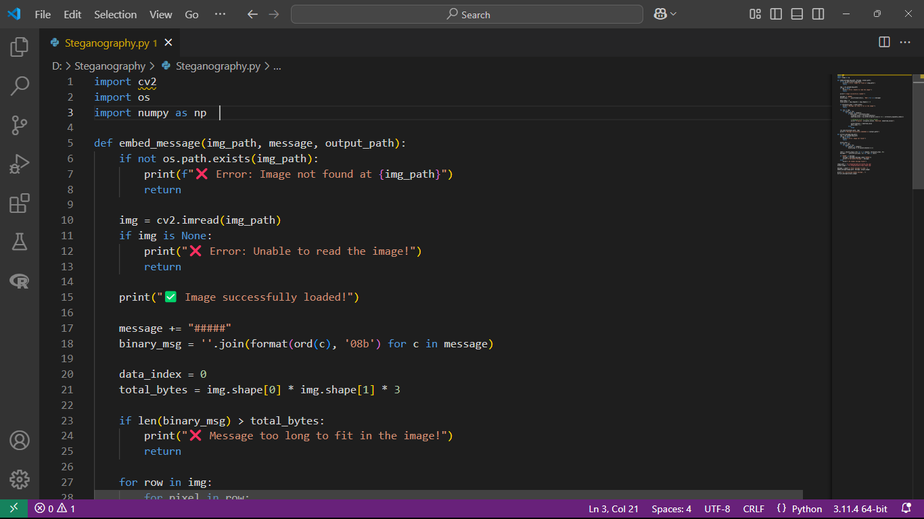
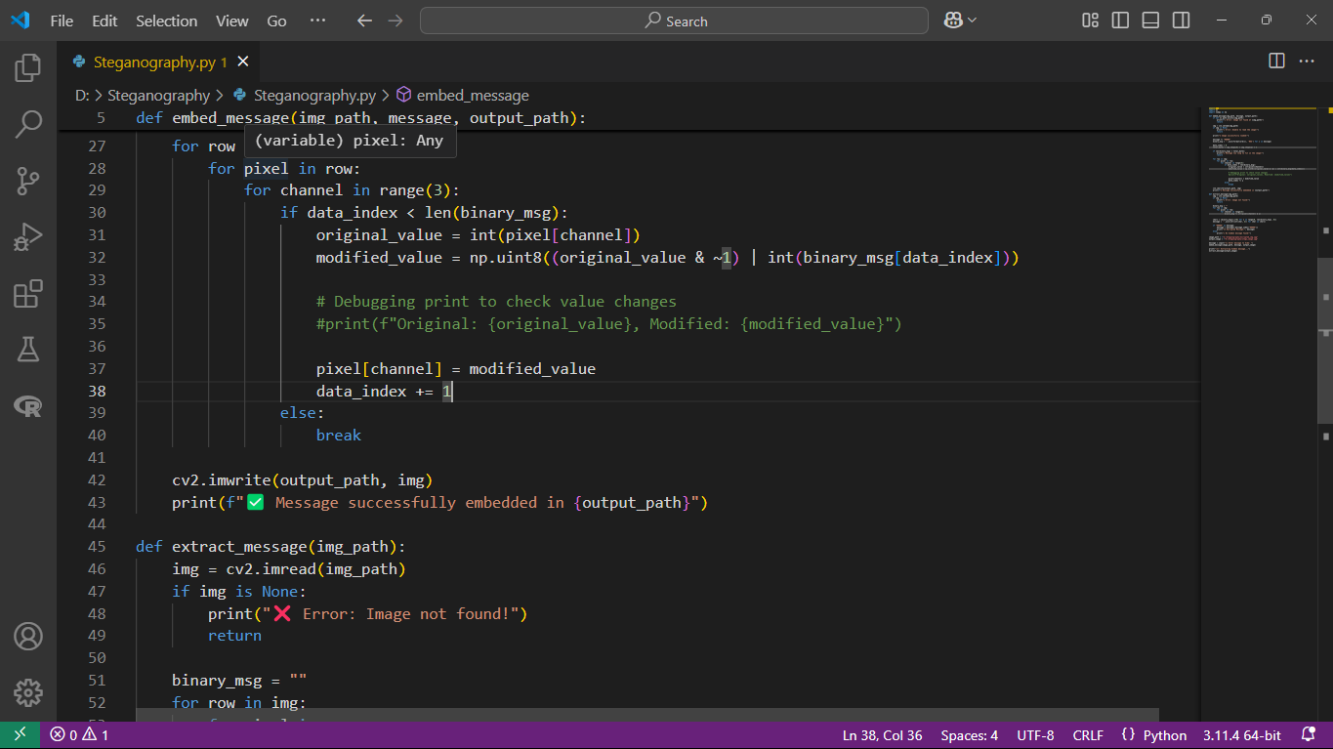
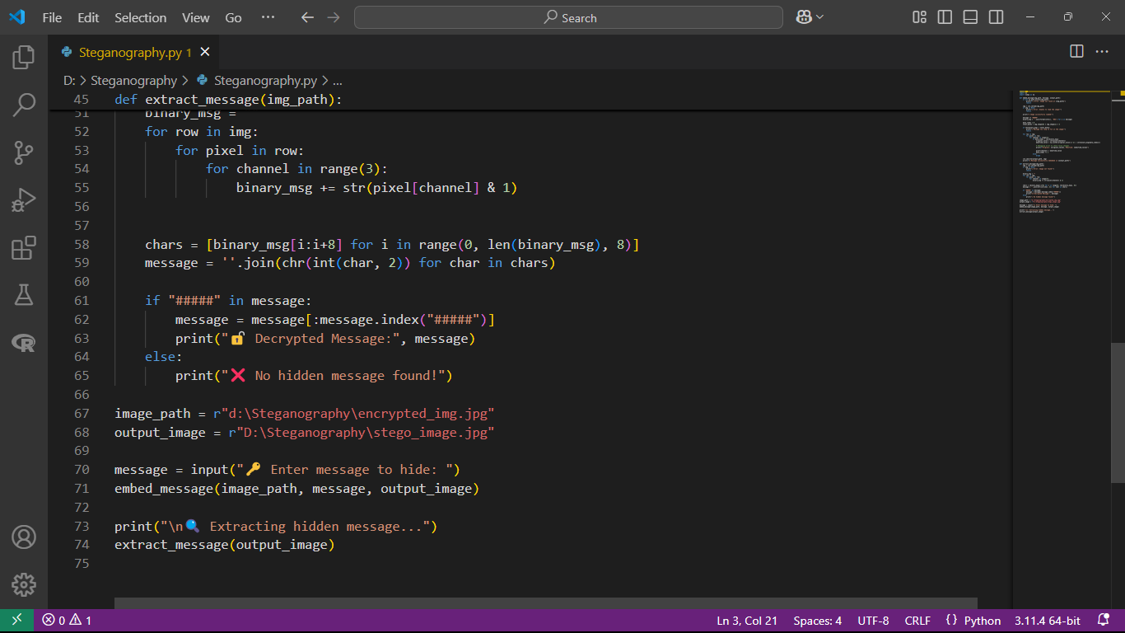
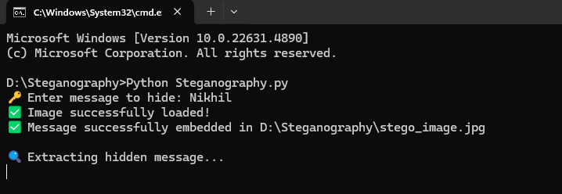
Results

Slide 8
Conclusion
The secure picture steganography system offers a reliable solution for secret communication
by skillfully fusing steganographic and encryption methods. It guarantees great security and
resistance to discovery by inserting encrypted data without causing discernible visual degradation.
This approach maintains visual integrity while strengthening data confidentiality and integrity,
making it ideal for cybersecurity, law enforcement, and secure messaging. Its adaptability to evolving threats
makes it a valuable tool for secure data transmission in various sensitive applications.

Slide 9
GitHub Link
https://github.com/GodNikhilYT/Steganography/blob/main/README.md

Slide 10
Future scope(optional)
Combining AI with adaptive steganography method.
Creating of models that are resistant to real-time detection.
Extension of audio and video steganography for more extensive uses.
Adoption of safe cloud-based communication platforms.
Improved steganalysis resistance with adversarial tactics based on deep learning.

Slide 11
THANK YOU

